Slide 1
Static Block
Course Code: CSC 1205
Course Title: Object Oriented Programming 1
Dept. of Computer Science
Faculty of Science and Technology
Lecturer No: | 5 | Week No: | 3 | Semester: | Summer 19-20
Lecturer: | kawsur & kawsur@aiub.edu

Slide 2
Lecture Outline
Introduction to Static Block
Multiple Static Initializer Blocks
Alternative ways to Static Block

Slide 3
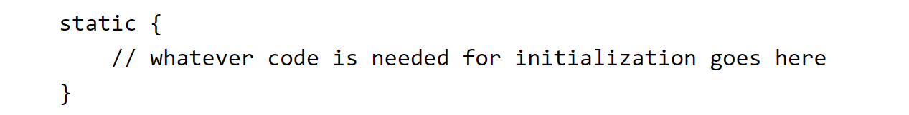
Introduction to Static Block
What is Static Block
A static block is a normal block of code enclosed in braces, { }, and preceded by the static keyword.
A static block is also called static initialization block.
Here is an example:

Slide 4
Introduction to Static Block
More about Static Block
A static block is executed only once, when a program begins execution (or, more precisely, when its class is first loaded).
Static block is used to initialize static variables.

Slide 5
Multiple Static Blocks
Multiple Static Blocks
A class can have any number of static initialization blocks, and they can appear anywhere in the class body.
The static initializer blocks will be executed in the order in which they appear in the code.

Slide 6
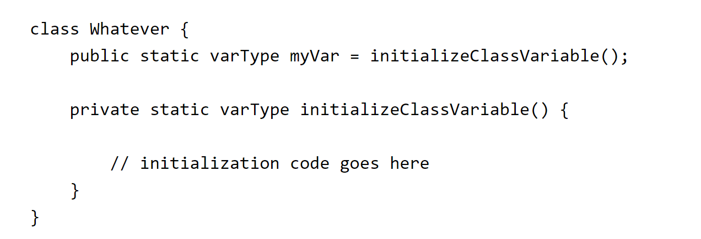
Alternative ways to Static Block
Private Static Method
There is an alternative to static blocks—you can write a private static method:
The advantage of private static methods is that they can be reused later if you need to reinitialize the class variable.

Slide 7
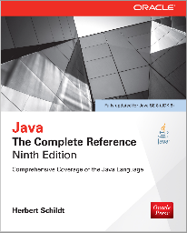
Books
Java The Complete Reference- Ninth Edition by Herbert Schildt

Slide 8
References
https://docs.oracle.com/javase/tutorial/

